Slide 1
22 Immutable Laws of Branding

Slide 2
21st and 22nd Law of Branding
Group Members:
Rehan Shafqat 22L-7914
Huzaifa Kashif 22L-7867
Ali Imran 22L-7854
Haider Abbas 22L-7863
Ammar Khan 22L-7824

Slide 3
21st Law
No brand will live forever. Euthanasia is often the best solution.
Law of Mortality

Slide 4
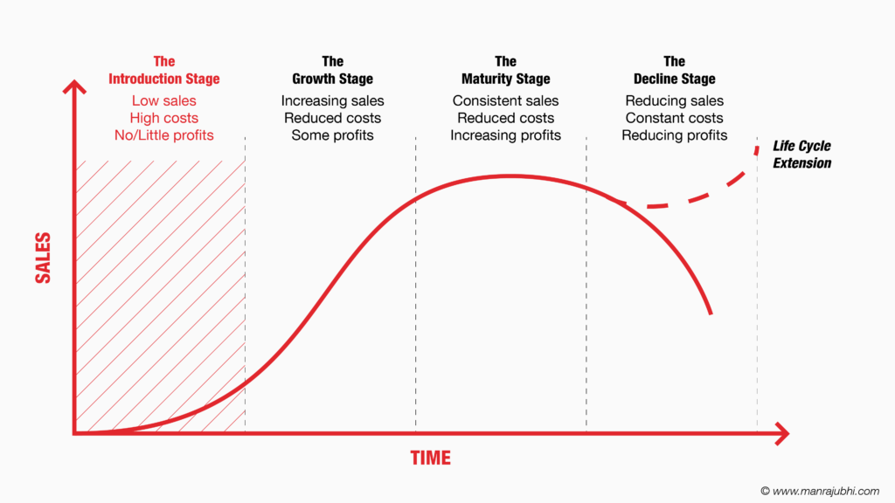
Introduction
There is a lifecycle of a brand with different stages . Brands are introduced in the market , they grow , mature and finally decline.

Slide 5
Reasons for Mortality
01
02
03
Failure to Innovate
Ineffective Marketing
Intense Competition

Slide 6


Failure to Innovate

Slide 7
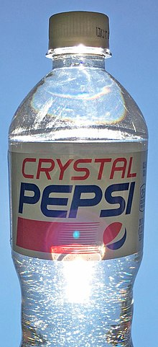
Ineffective Marketing

Slide 8


Intense Competition

Slide 9
“Branding Laws are immutable, but Brands are not.

Slide 10
Ways to avoid failure due to mortality
01
02
03
Multiple Brands Launching
Partner with Innovative Brands
Continuous Innovation

Slide 11



Multiple Brand Launching

Slide 12


Partner with Innovative Brands
&

Slide 13



Continuous Innovation

Slide 14
Conclusion
Mortality of Brand is must.
Can be avoided to some extend only.

Slide 15
22nd Law
The most important aspect of a brand is its single-mindedness.

Slide 16
Explanation
01
02
03
What is Singularity?
Rule of Uniqueness
Importance of Uniqueness

Slide 17
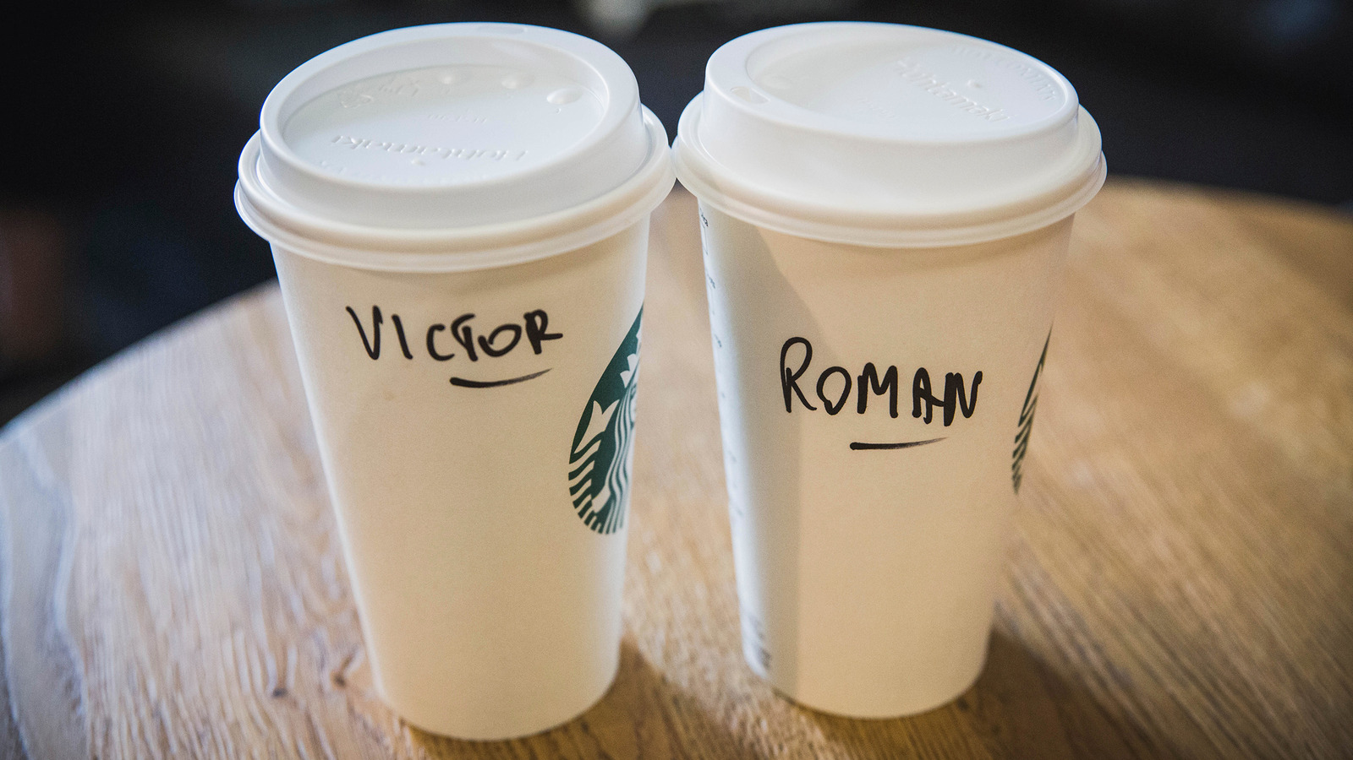

Examples of Brands

Slide 18
The Italian Notebook

Slide 19



Gaming Console?

Slide 20

The Best-Selling Gaming Console

Slide 21

The (purana) Best-Selling Gaming Console

Slide 22

What do they sell?

Slide 23
THANK YOU! ANY QUESTIONS?

